Slide 1


Overview
•Total Profit
•Gross Profit %
•Looking Ahead

Slide 2


2024 - $852,472
2025 - $1,256,837
Overall Company Numbers
Notes:
Its important to celebrate when the company is doing well but to also take advantage of the momentum, look at what works and continue to make adjustments that fine tune our processes.

Slide 3
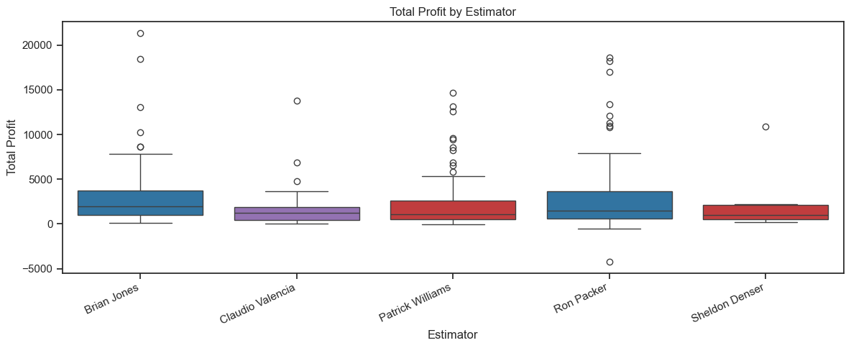
Total Profit by Estimator
Notes:
Painting, in blue, has the widest range, showing that paint jobs can greatly vary. Carpentry, in red, and Claudio’s blend of painting and carpentry are mush tighter. Extremely large or small job jobs show up less.

Slide 4
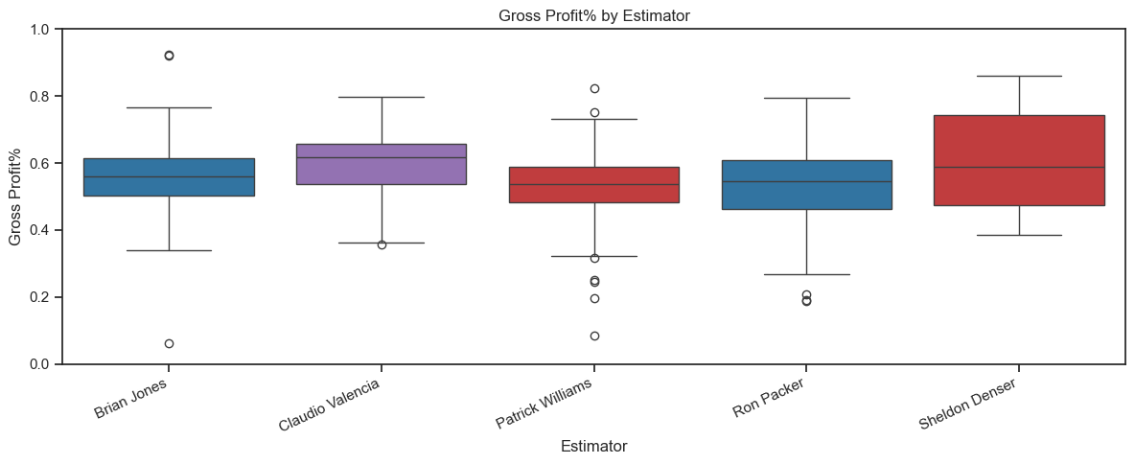
Gross Profit % by Estimator
Notes:
This shows Gross Profit by % so that it doesn’t outweigh larger jobs. This shows more consistency across the board, but Patrick needs to keep a closer eye on some of his jobs.

Slide 5
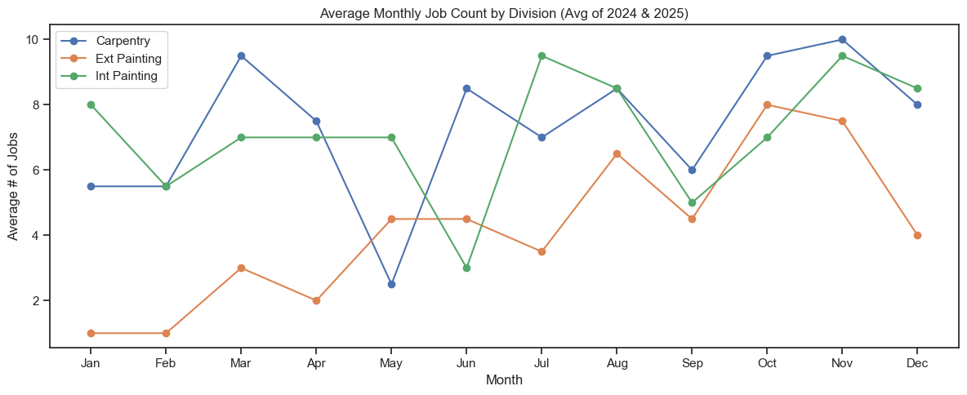
Notes:
This shows how job numbers change for each division throughout the year.

Slide 6
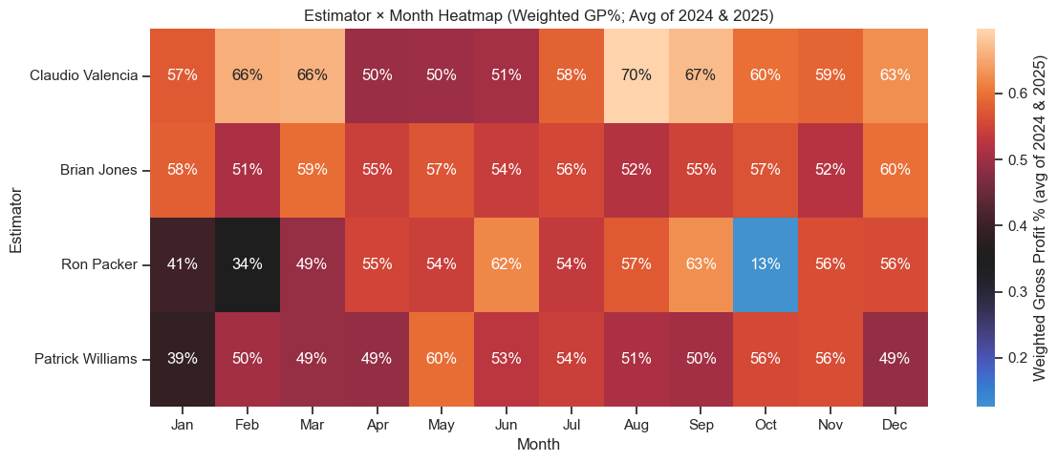
Estimator x Month Heatmap
Weighted GP%
Average of 2024 & 2025
Notes:
Here we see Gross Profit by % by Month for each Estimator. The months for 2024 and 2025 were averaged together. Weather and holidays have a great effect when work is done because much of our work directly impacts people’s living spaces. It is challenging to balance estimates and jobs thought the year but it’s important to maintain a consistent cashflow. Brian has the most consistency throughout the year.

Slide 7
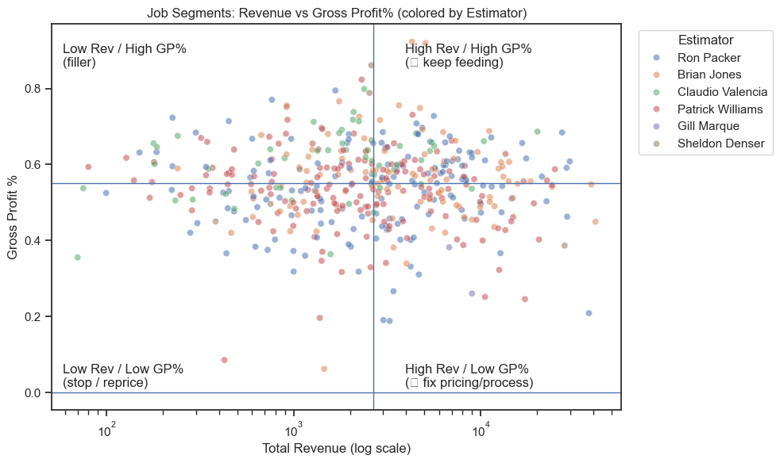
Notes:
Looking at Total Revenue and Gross Profit %. Its clear that no one estimator is landing High revenue/High GP% over others but its good to see the company as a whole is leaning toward the top right of the plotmap.

Slide 8
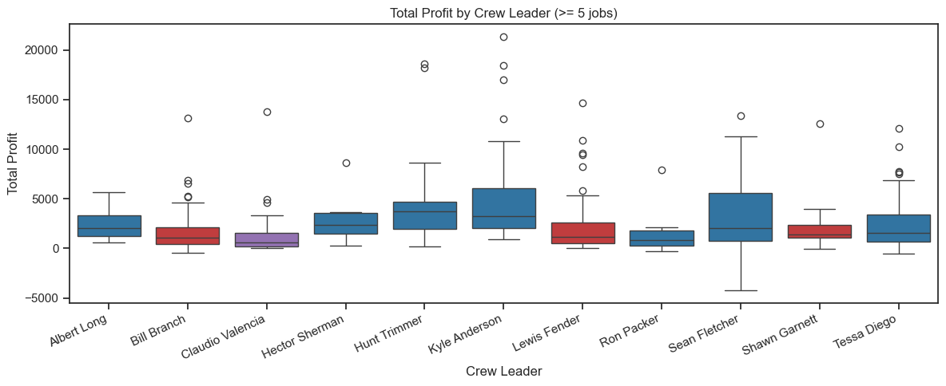
Total Profit by Crew Leader
Notes:
Total profit is spread out between crew leaders with a lot of higher outliers. This can be out of their hands especially if they get a very large or even small job. Notice that Ron Packer has one of the lowest top outliers and has one of the lowest medians. This will tell a better story in the next slide.

Slide 9
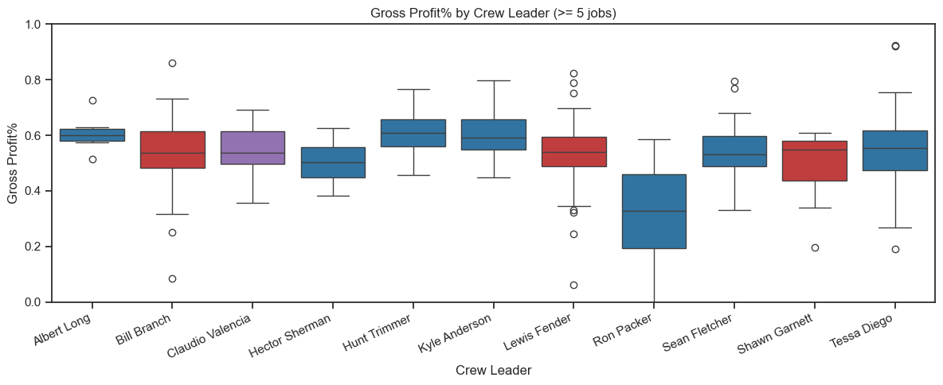
Gross Profit % by Crew Leader
Notes:
Ron Packer, owner of the company, should not be leading jobs. He may be one of the best painters out there, but he needs to be running the company, not running jobs. Lewis Fender is the least consistent while Albert Long shows the most consistency.

Slide 10
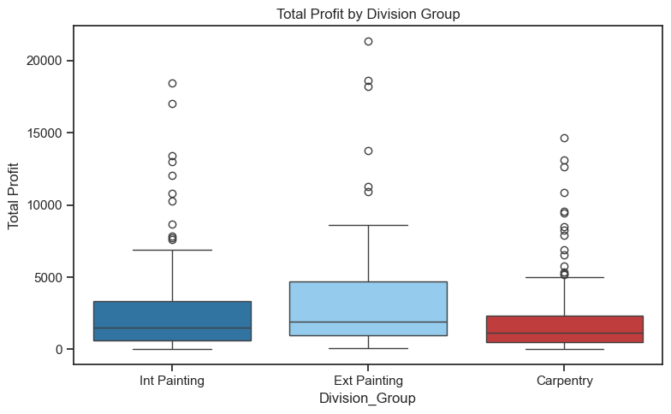
Total Profit by Division
Notes:
Exterior jobs can range from entire multimillion dollar homes getting a full paint job to just painting a door which is why there are so many high outliers, but the “Bread & Butter” jobs are sub $5k.

Slide 11
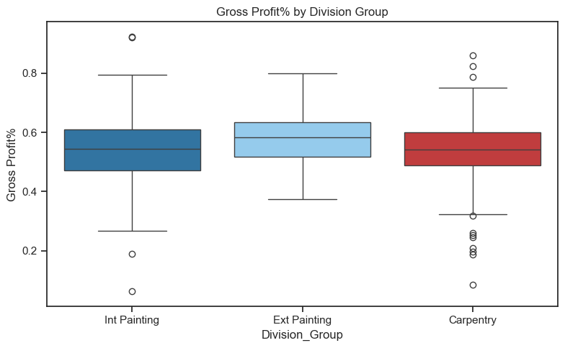
Gross Profit % by Division
Notes:
When looking at Gross Profit % by Division, Exterior Painting is most consistent with the smallest range and zero outliers. *Note – One ext painting job was removed because it had a $4k loss. This job was more than an outlier, it was a stack of anomalies that became such a disaster due to a lot of outside factors.

Slide 12
Estimator
Crew Leader
Customer Zip Code
Division
Contracted Revenue
Contracted Estimated Hours
How do we look ahead?
Notes:
These parameters are key and we will continue to track them across all our jobs.

Slide 13
Learns from past jobs to spot patterns that impact profit
Predicts profit on new jobs to flag potential risk early
Improves as more completed jobs are added
Helps us decide where to review, adjust, and improve
How do we look ahead?
Notes:
We train a model using these job-level values. First, it helps us look back and identify a small, focused set of past jobs worth reviewing—so we can spot patterns, holes in the process, missed assumptions, unexpected costs, or anything else that may have pulled down the profit margin.
Second, it gives us a predicted profit for each new job before we start. Now, that prediction isn’t a magic mirror or a time machine—but it is a useful signal. It helps us flag jobs that might not perform as well as expected, so we can take a closer look early and consider what changes could raise the odds of hitting our target profit.
And this isn’t a one-and-done model. It’s active and flexible. Every time we complete a job and log the outcome, the model gets another real-world example to learn from. Over time, it should become more accurate—and our goal is to improve right alongside it as we refine how we estimate, plan, and execute.
Alright—let’s walk through how it works.

